Slide 1

Laboratory & Professional skills for Bioscientists Term 2: Data Analysis in R
Week 3: Hypothesis testing, data types, reading data in to R and saving figures in reports

Slide 2
Last week…
Why we need statistics: Are these results, or ones as probable or less probable, so unlikely that we suspect an effect?
This week…
More on the logic and what governs the type of test we use?
Data types

Slide 3
The logic of ‘hypothesis’ testing
Slide from last week:
Have a ‘null’ hypothesis’
Calculate probability of getting your data if that null hypothesis is true
If the probability is less than 0.05 reject the null hypothesis
Frequentist/classical statistics

Slide 4
Summary of this week
We will consider how we can classify variables in terms of the type of values they can take and their role in analysis and the impact these have on the tests that we conduct.
In RStudio we will cover reading in data files of various formats, data types, summarising and plotting data. We also cover saving figures and laying out a report in word.

Slide 5
Learning objectives for the week
By actively following the lecture and practical and carrying out the independent study the successful student will be able to:
to able to explain what response and explanatory variables are, distinguish between data types and describe how these impact choice of test (MLO 1 and 2)
demonstrate the process of hypothesis testing with an example and evaluate potential inferences (MLO 1 and 2)
read in data in to RStudio, create simple summaries and plots using manual pages where necessary (MLO 3)
create neat reports in Word which include text and figures (MLO 4)

Slide 6
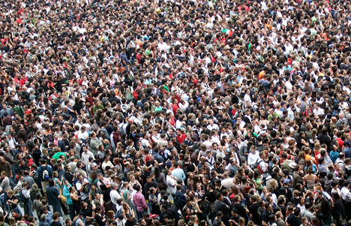

Science – generalisation
sample
Possible to measure
population
Impossible to measure
We draw inferences about the population(s) from the sample(s) based on statistics
Notes:
Why inferential statistics are needed

Slide 7
Uses of statistics
Estimation
what is the mean of the population?
Hypotheses testing
e.g., is there a difference between 2 means (t-test)
e.g., is the expected number of observations what we expect (chi-squared test)

Slide 8
Uses of statistics
Estimation
what is the mean of the population?
Hypotheses testing
e.g., is there a difference between 2 means (t-test)
e.g., is the expected number of observations what we expect (chi-squared test)
L04 and W04: Describing normal distributions and Confidence Intervals
L03 and W03; L05 and W05 to L08 and W08

Slide 9
Regardless, the choice of statistic depends on ….
Type of data
The type of values a variable can take: Discrete or continuous?
Their role in the analysis
Which is the response and which is/are explanatory?

Slide 10
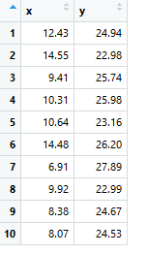
Overview
‘Experiments’
Some things we control, choose or set
Something
we measure
Independent variables
Explanatory variables
The ‘x’ s
Dependent variables
Response variables
The ‘y’ s
Which variable is the response? (2)
Which variables are explanatory? (2)
What kind of values can they take? (1)

Slide 11
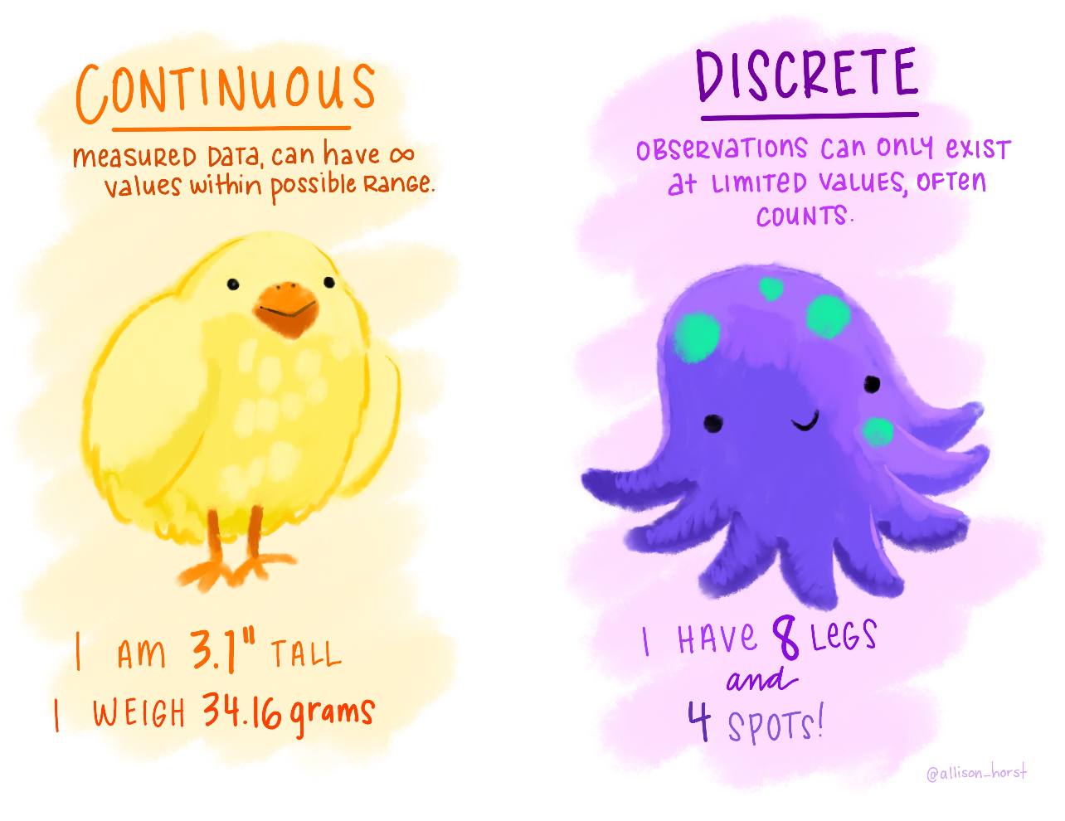
The choice of statistic depends on: Type of data
Two main types
discrete
continuous

Slide 12
The choice of statistic depends on: Type of data - discrete
Discrete
Categories (not quantitative)
Counts (quantitative but discrete)

Slide 13
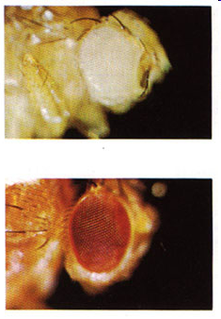
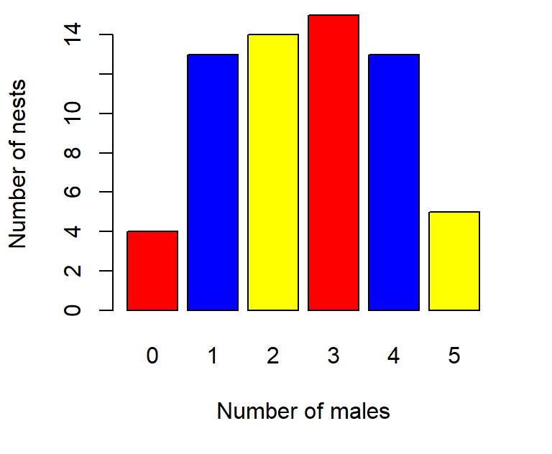
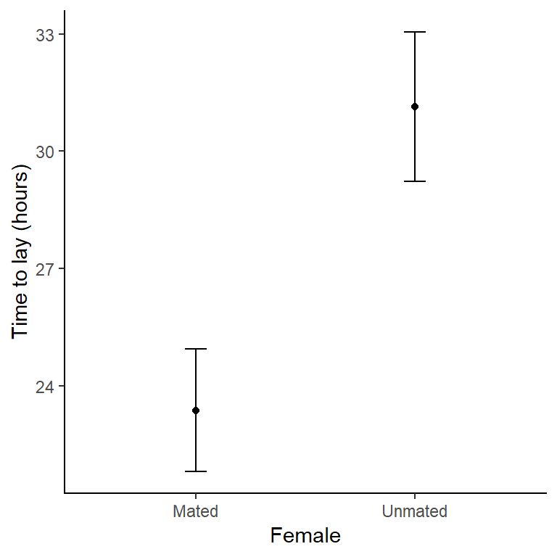
The choice of statistic depends on: Type of data - discrete
Categories
No scale e.g., colour, species
Often an ‘explanatory’ variable
Category

Slide 14
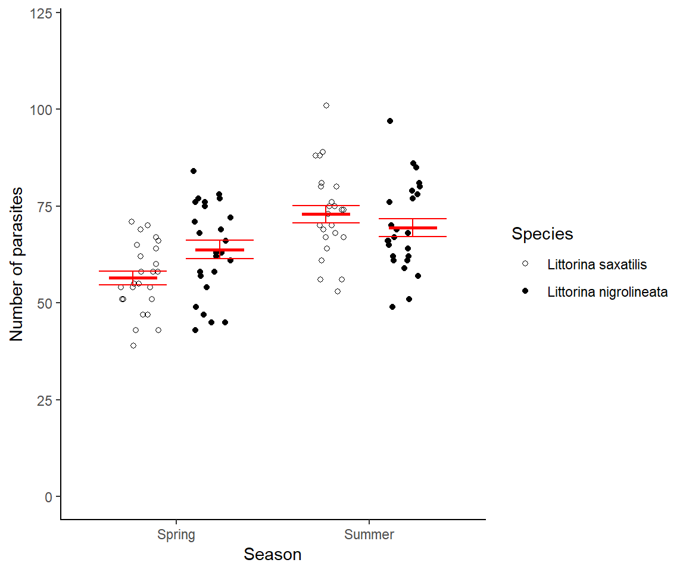
The choice of statistic depends on: Type of data - discrete
Counts
Normally a ‘response’ variable

Slide 15
The choice of statistic depends on: Type of data - continuous
e.g., length, height, concentration
Infinite number of possible values
Can be a response or an explanatory
Normally a response variable

Slide 16
The choice of statistic depends on: Type of data
Theory vs practice
Limit of measurement
Numbers of hairs on head: discrete but can be treated as continuous
Height to nearest metre: continuous but discretised by measurement
Notes:
Not as clear cut as it seems. Some discrete data can be treated as continuous and some continuous data are effectively discretised.

Slide 17
The choice of statistic depends on ….
Type of data
What kind of values? Discrete or continuous?
Their role in the analysis
Which is the response and which are the
explanatory
What is the relationship between them?
Rest of the module!

Slide 18
Hypothesis Testing: deeper
Set up H₀ “no effect”
Test generates a test statistic from data (a summary)
Converted to a probability (p-value) = prob of data if H₀ is true
p ≤ 0.05 reject H₀; p > 0.05 do not reject H₀

Slide 19
Hypothesis Testing – relationship to L1 example
Set up H₀
There is no effect of maternal poverty on birthweight
Notes:
Relate to binomial test we carried out

Slide 20
Hypothesis Testing – relationship to L1 example
Test generates a test statistic from the data
‘Converted’ to a probability (p-value) = Probability of getting a test statistic of that size or as extreme or more extreme if H₀ is true

Slide 21
Hypothesis Testing – relationship to L1 example
Compare our p-value to 0.05
p ≤ 0.05 reject H₀
p > 0.05 do not reject H₀
In that example, our p-value was 0.096 Thus: We do not reject the null hypothesis.
Our sample is consistent with poverty having no effect.

Slide 22
Hypothesis Testing: The p-value
Probability of result if null hypothesis true
if we calculate p = 0.45 we can expect results as extreme or more extreme as those we observe 45% of the time.
0.05 is the crucial level
If p ≤ 0.05. We reject the null hypothesis
And conclude there is a significant difference between our sample and what we would expect if there was no effect

Slide 23
Hypothesis Testing: Type 1 and type 2 errors
Inherent in the approach - not ‘mistakes’ you can prevent
Decision after testing | (unknown) True state of H₀
 | True | False
Reject (evidence it is false) | Type 1 error | Correct
Do not reject (no evidence it is false) | Correct | Type 2 error

Slide 24
Hypothesis Testing: Type 1 and type 2 errors
For our birthweight example…..p > 0.05 (0.096)
Decision after testing | (unknown) True state of H₀
 | True | False
Reject (evidence it is false) | Type 1 error | Correct
Do not reject (no evidence it is false) | Correct | Type 2 error

Slide 25
Learning objectives for the week
By actively following the lecture and practical and carrying out the independent study the successful student will be able to:
to able to explain what response and explanatory variables are, distinguish between data types and describe how these impact choice of test (MLO 1 and 2)
demonstrate the process of hypothesis testing with an example and evaluate potential inferences (MLO 1 and 2)
read in data in to RStudio, create simple summaries and plots using manual pages where necessary (MLO 3)
create neat reports in Word which include text and figures (MLO 4)

